Slide 1
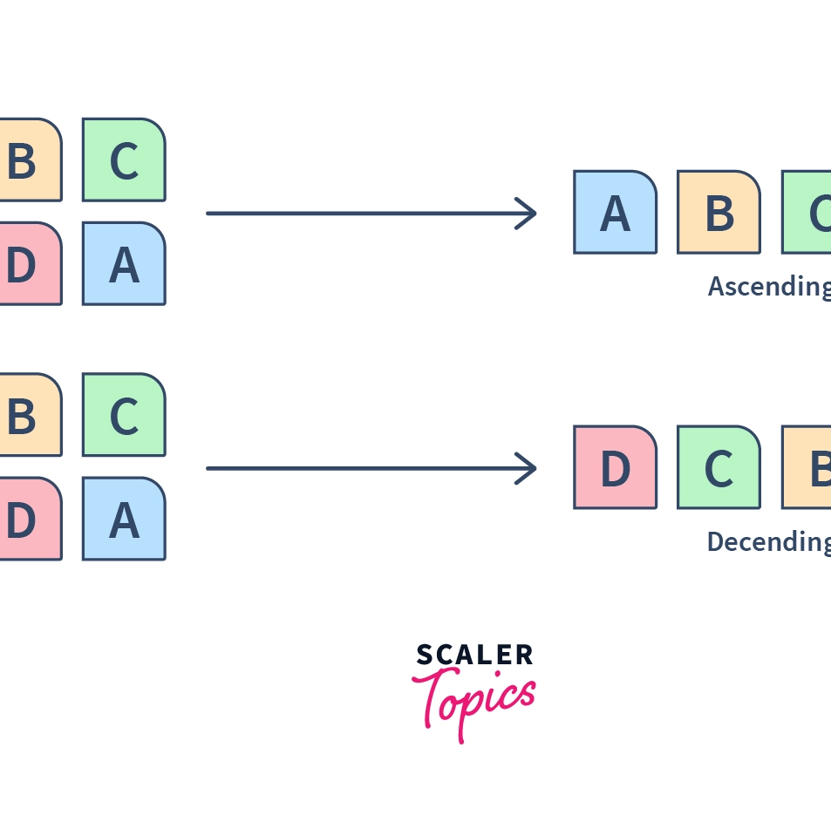
Objective:
The objective of a sorting visualizer is to provide a visual representation of how different sorting algorithms work. It helps users to see the step-by-step process of sorting elements in real-time, which can aid in understanding the differences between various sorting methods.

Slide 2

Sorting Visualizer: Understanding Sorting Algorithms Better
Sorting algorithms are essential tools for organizing data efficiently.
The Sorting Visualizer is a tool designed to help users understand how sorting algorithms work and to visualize the sorting process.
By using the visualizer, users can learn the intricacies of sorting algorithms and how they can be used to solve complex data organization problems.

Slide 3

Types of Sorting Algorithms
Types of Sorting Algorithms: Bubble Sort, Selection Sort, Insertion Sort, Merge Sort, Quick Sort
Bubble Sort: Sorts elements by repeatedly swapping adjacent elements if they are in the wrong order.
Selection Sort: Finds the smallest element and swaps it with the first element. Then, it finds the second smallest element and swaps it with the second element, and so on.
Insertion Sort: Sorts elements by inserting each element into its proper position.
Merge Sort: Divides the input into two halves, sorts each half separately, and then merges the sorted halves.
Quick Sort: Divides the input into two parts, the low part and the high part, based on a pivot element. Then, it sorts each part separately.

Slide 4
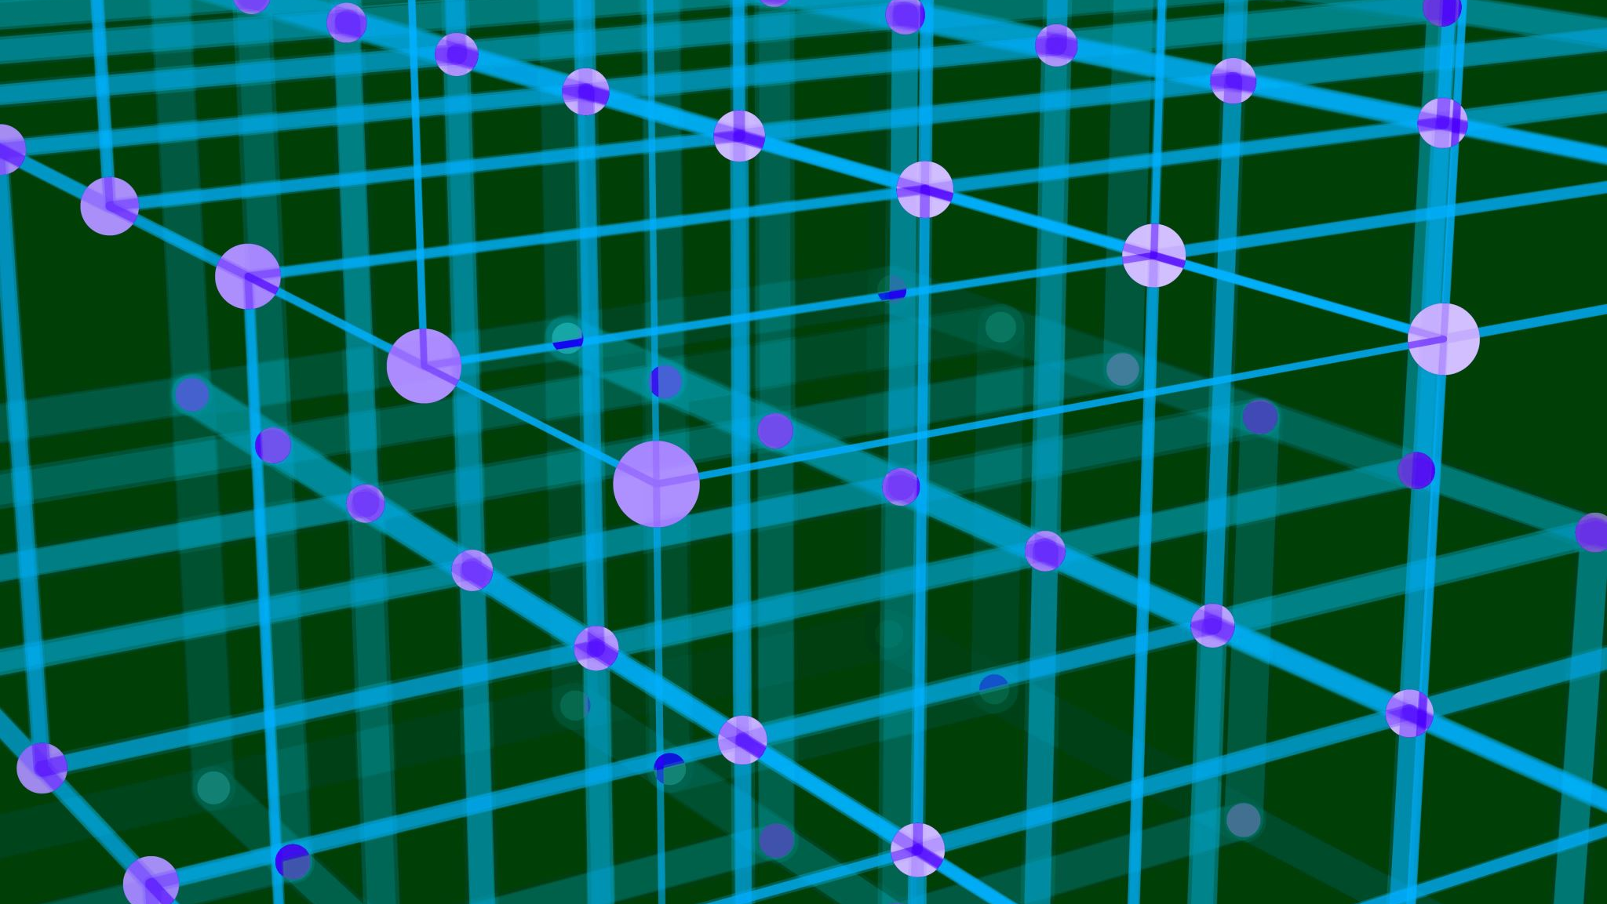
Methodology
Methodology Used to Create Sorting Visualizer
Programming Language: Python
Libraries Used: Pygame, NumPy, Matplotlib
Challenges Faced: Designing an intuitive user interface, optimizing the performance of the visualizer, and handling large input data sets.
Demonstration: A brief video or screenshots of the Sorting Visualizer in action.

Slide 5
Block Diagram
User Interface
Sorting Algorithm
Sorting Visualizer
Data Visualization
Sorting Animation
User Feedback
Repeat

Slide 6

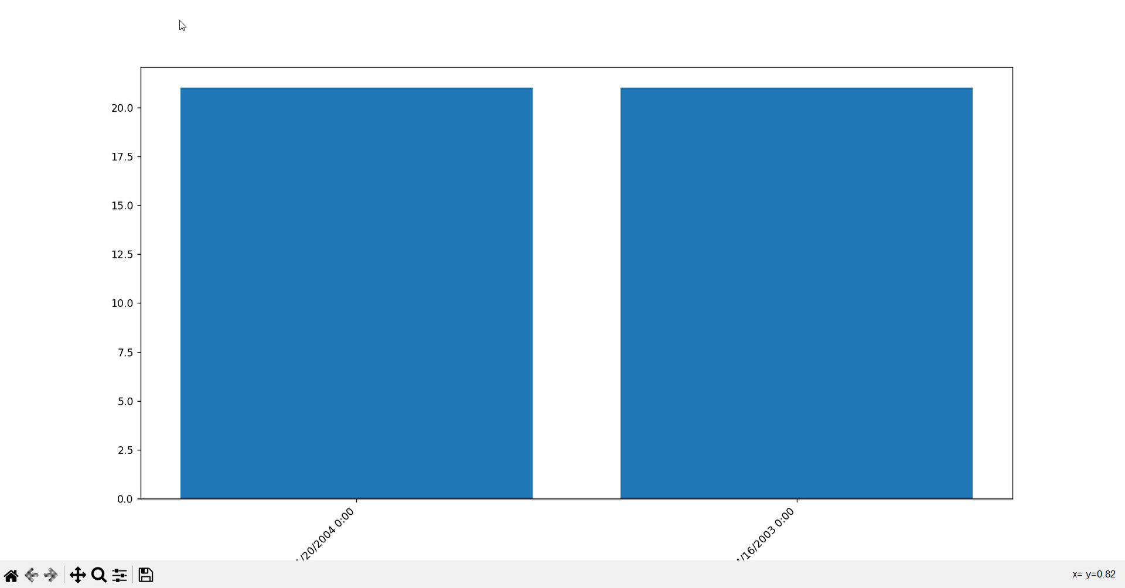
Demo for a Sales Data

Slide 7

Accomplishments
The Sorting Visualizer is an easy-to-use tool that allows users to understand sorting algorithms better, visualize the sorting process, and experiment with different input data sets.
The Sorting Visualizer has received positive feedback from users and has helped many people learn sorting algorithms more effectively.
The Sorting Visualizer has been used by students, teachers, and professionals in a variety of fields, including computer science, data science, and engineering.
The Sorting Visualizer has inspired other developers to create similar tools and visualizations for other algorithms and data structures.

Slide 8
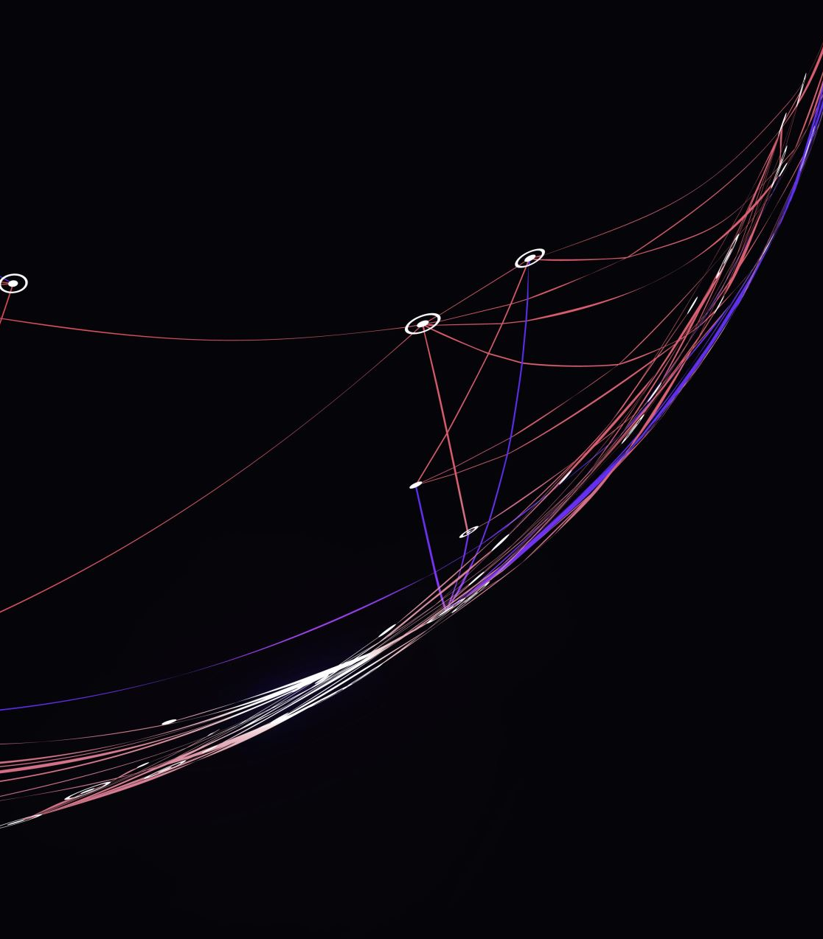
References
"Introduction to Algorithms" by Thomas H. Cormen, Charles E. Leiserson, Ronald L. Rivest, Clifford Stein: This book provides a comprehensive introduction to algorithms, including sorting algorithms. It is a standard textbook in many computer science programs.
Sorting Algorithms by GeeksforGeeks: This website provides detailed explanations and examples of various sorting algorithms, including bubble sort, selection sort, insertion sort, merge sort, and quick sort.
Sorting Visualizer by Clement Mihailescu on GitHub: This is a popular open-source project that provides a visual interface for sorting algorithms. It is written in Python and uses the Pygame library for graphics.

Slide 9

Thank You

